Slide 1
1012 Homework Exercise
4110E230

Slide 2


Exercise 1
Print the second item in the fruits list.
Answer

Slide 3


Exercise 2
Change the value from "apple" to "kiwi", in the fruits list.
Answer

Slide 4


Exercise 3
Use the append method to add "orange" to the fruits list.
Answer

Slide 5


Exercise 4
Use the insert method to add "lemon" as the second item in the fruits list.
Answer

Slide 6


Exercise 5
Use the remove method to remove "banana" from the fruits list.
Answer

Slide 7


Exercise 6
Use negative indexing to print the last item in the list.
Answer

Slide 8


Exercise 7
Use a range of indexes to print the third, fourth, and fifth item in the list.
Answer

Slide 9


Exercise 8
Use the correct syntax to print the number of items in the list.
Answer

Slide 10
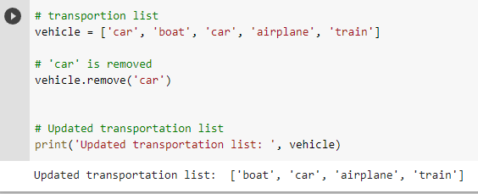
Example 3: Deleting element that doesn't exist

Slide 11
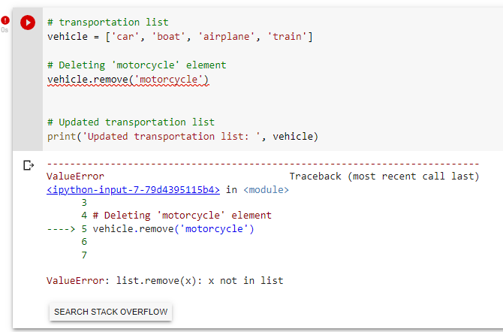
Example 3: Deleting element that doesn't exist

Slide 12
CHINESE NAME: 彭哈帕
STUDENT ID: 4110E230
ENGLISH NAME: James Ryan H. Pregon
NICKNAME: Kaori
Email: jamesryanpregon@gmail.com
GITHUB: https://github.com/PengHaPa/cs2022.git

